Slide 1
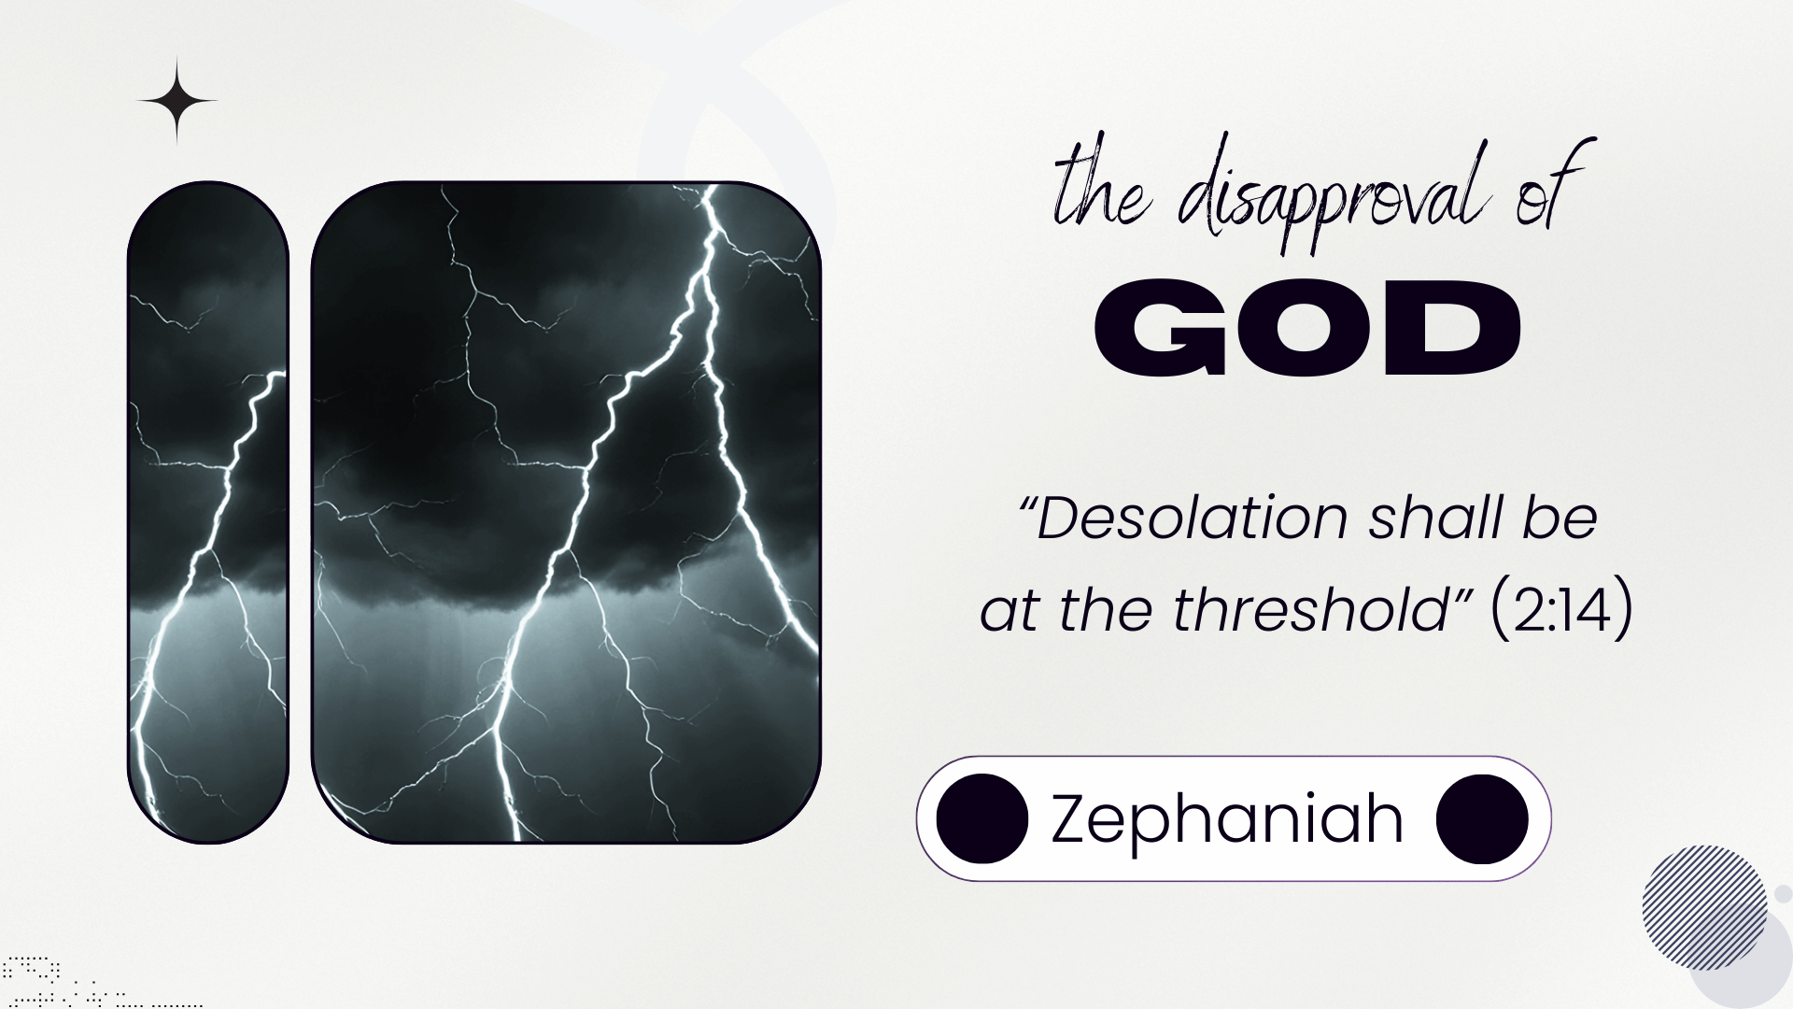

Slide 2
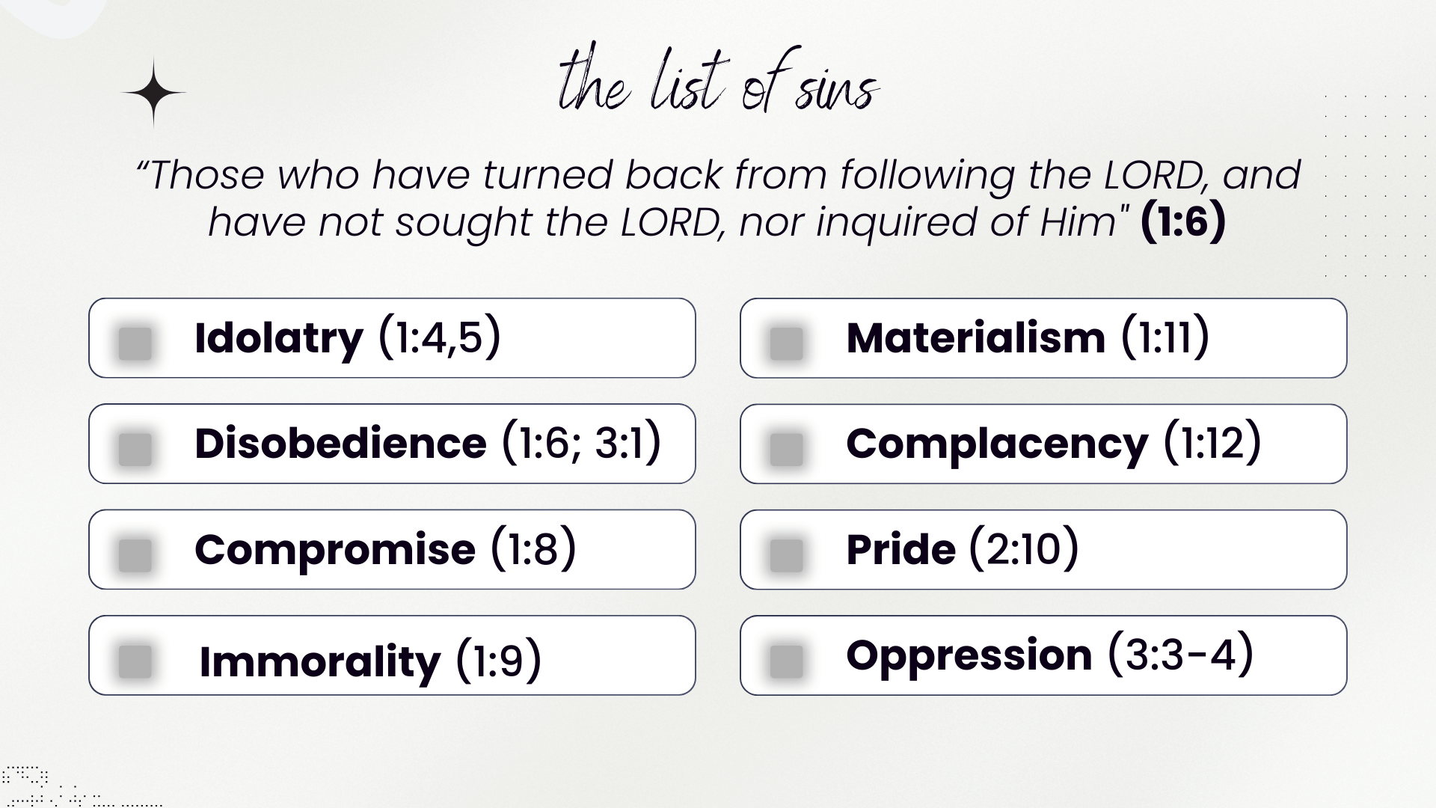

Slide 3
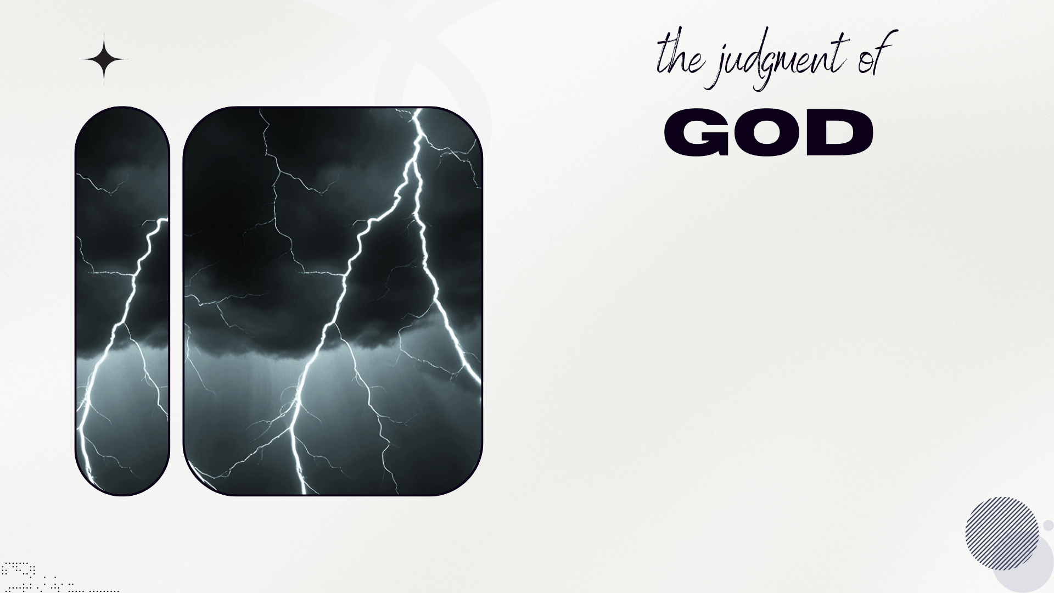
The Message of Zephaniah (God’s Judgment)
We Know God’s Awesomeness (2:11)
Not Even the Mighty Can Stand (2:9,15)

Slide 4

We have a new covenant in these last days! That does not change God's continued involvement in the affairs of men

